Slide 1

Exploratory Data Analysis
Cross-selling Recommendations for Bank Products
Presented by: Jesumbo Oludipe
14/05/2023

Slide 2

Agenda
Problem Description
Business Understanding
Data Understanding
Exploratory Data Analysis
Recommendations

Slide 3
Problem Description
XYZ Credit Union sells various banking products including credit cards, deposit accounts, retirement accounts, and safe deposit boxes.
Existing customers are not showing interest in purchasing more than one product.
This indicates a missed opportunity for cross-selling to customers.
XYZ Credit Union has partnered with ABC Analytics to analyze the data and provide actionable insights.

Slide 4
Business Understanding
XYZ Credit Union has a large customer base in Latin America. Despite this, the bank's existing customers do not purchase more than one product.
This project aims to identify factors affecting cross-selling and understand customer behavior.
The ultimate goal is to propose strategies to improve the bank's overall performance in selling multiple products to its existing customers.

Slide 5
Data Understanding
Dataset includes comprehensive customer information such as age, gender, and country of residence.
Provides information on bank products that customers own, including credit cards, deposit accounts, retirement accounts, safe deposit boxes, and more.
Contains 48 features (columns) and 13,647,308 observations (rows).
Offers a large volume of data for analysis.
Provides valuable insights into the bank's customer base and product preferences.

Slide 6
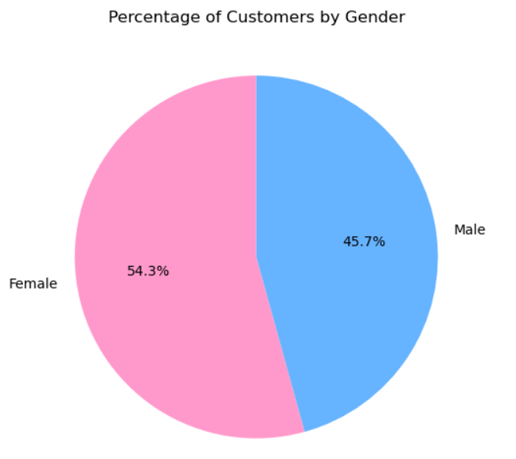
Exploratory Data Analysis (EDA)
Exploratory Data Analysis (EDA) is a crucial step in any data analysis project, it helps us understand the data structure, uncover patterns and relationships, and identify potential outliers or anomalies.
The analysis of the gender distribution of customers in the dataset showed that the majority of the customers were female (54.29%) and male customers made up a slightly smaller percentage (45.71%).

Slide 7
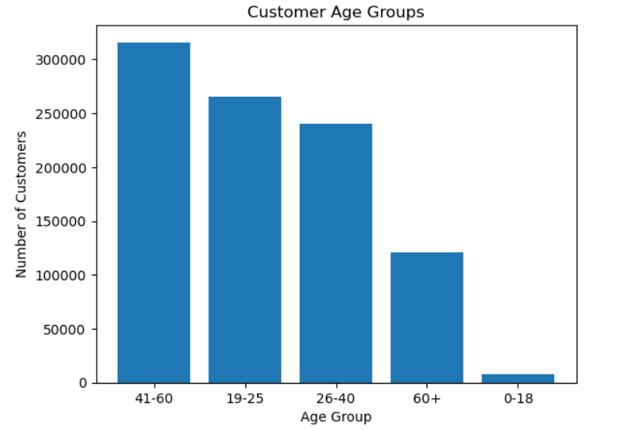
Exploratory Data Analysis (EDA)
The majority of customers fall in the age group of 41-60 years old (33.26% of total customers).
The age group of 19-25 years old is the second-largest (27.90%).
The age group of 0-18 years old is the least represented (0.86%).
Bank can focus on tailoring marketing strategies towards the 41-60 age group to target the largest portion of its customer base.

Slide 8
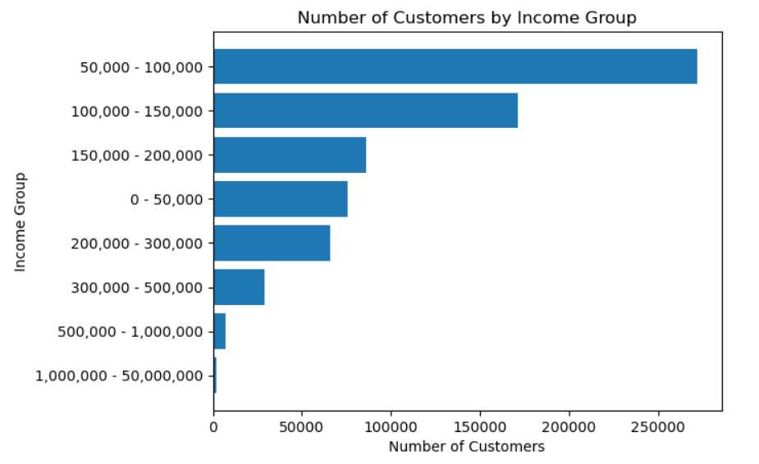
Exploratory Data Analysis (EDA)
The majority of customers fall in the income group of 50,000-100,000 (38.35%)and 100,000-150,000 (24.17%).
Customers in higher income groups (1,000,000-50,000,000) make up a small percentage of the customer base.
Bank can focus marketing efforts toward income groups with the highest representation (50,000-100,000 and 100,000-150,000) to retain and attract more customers.

Slide 9
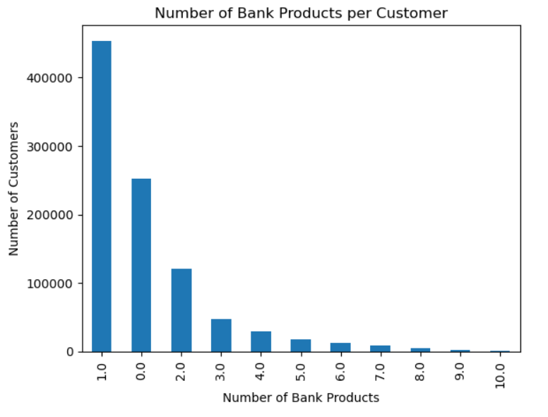
Exploratory Data Analysis (EDA)
Analysis of bank customer data revealed significant potential for cross-selling and revenue growth.
Almost half of customers have only one bank product, while over a quarter have none.
Vast opportunity to increase the number of bank products held by customers.
Identify customer needs and preferences to offer relevant products.
Personalized marketing strategies can be targeted toward different customer segments.

Slide 10
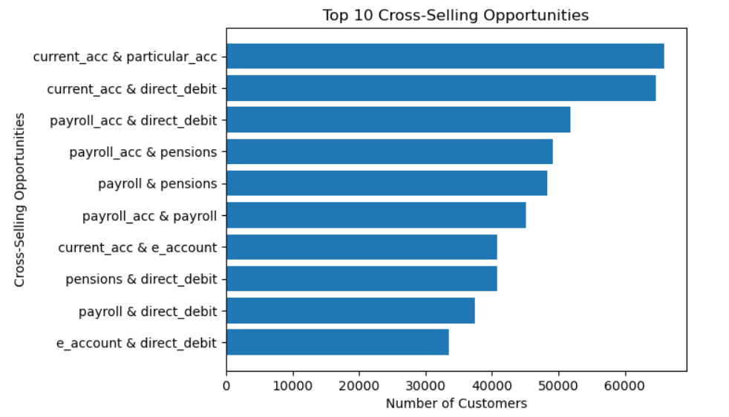
Exploratory Data Analysis (EDA)
Identified top 10 cross-selling opportunities for the bank, such as current accounts and particular accounts, payroll accounts and pension plans, and direct debits.
Bank should monitor usage patterns of different account types and adjust marketing strategies accordingly to retain and attract customers.
Targeted marketing campaigns can be created to promote cross-selling opportunities and generate more revenue from the existing customer base.

Slide 11
Recommendations
Based on the analysis, here are some recommendations to increase cross-selling and revenue at XYZ Credit Union:
Develop targeted marketing campaigns based on customer behavior analysis.
Train employees on cross-selling strategies and provide ongoing support.
Streamline product offerings to reduce complexity and increase understanding.
Improve overall customer experience to build trust and loyalty.
Focus on customers who own only one product for cross-selling opportunities.
Analyze product bundles to offer discounts and encourage additional purchases.
Conduct a thorough analysis of customer behavior to identify patterns.
Leverage customer feedback to improve existing products and develop new ones.
By implementing these recommendations, XYZ Credit Union can improve cross-selling and increase revenue from existing customers

Slide 12
Thank You

